Slide 1
Workshop Software Metrics

Slide 2
Software quality processes and tools
Quality
Iso standard
What are software metrics?
Why are they important?
How to measure them?
How to improve upon them?

Slide 3
Quality
Wikipedia:
In business, engineering, and manufacturing, quality – or high quality – has a pragmatic interpretation as the non-inferiority or superiority of something; it's also defined as being suitable for its intended (fitness for purpose) while satisfying customer expectations.

Slide 4
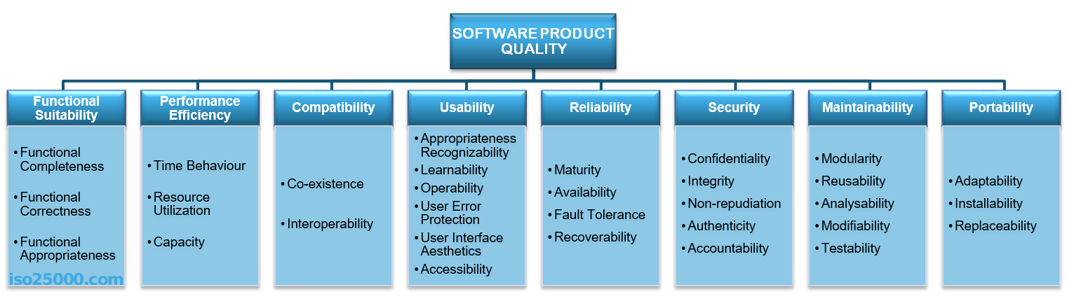
ISO 25010 standard
Notes:
Source: https://iso25000.com/index.php/en/
Software Quality can be split into multiple “ilities”. All of them are important, but depending on the business case, project or customer some might require more focus.
You already had a run-in with:
Maintainability:
- SOLID principles
multi tiered software architectures
use of frameworks
Reliability
Unit tests
CI
Functional suitability
User acceptance tests
Sprint deliveries and Agile way of working
In this workshop we will focus on using software metrics (and related tooling) to measure code quality.

Slide 5
Software metrics
When do we find our project to be of high quality?
Tested
Unit
Integration
Front end
End to End
Automated
User acceptance tests
Notes:
ISO 25010 does not contain all quality criteria we care about. A sample of what we at FHICT think contributes to high quality software

Slide 6
Software metrics
Also:
Code review by peer or senior
Design reviews
Coding standards
Architecture/design standards/principles (SOLID)
Static code analysis by tooling
Etc…
Notes:
But not only testing contributes to a higher quality of the project.

Slide 7
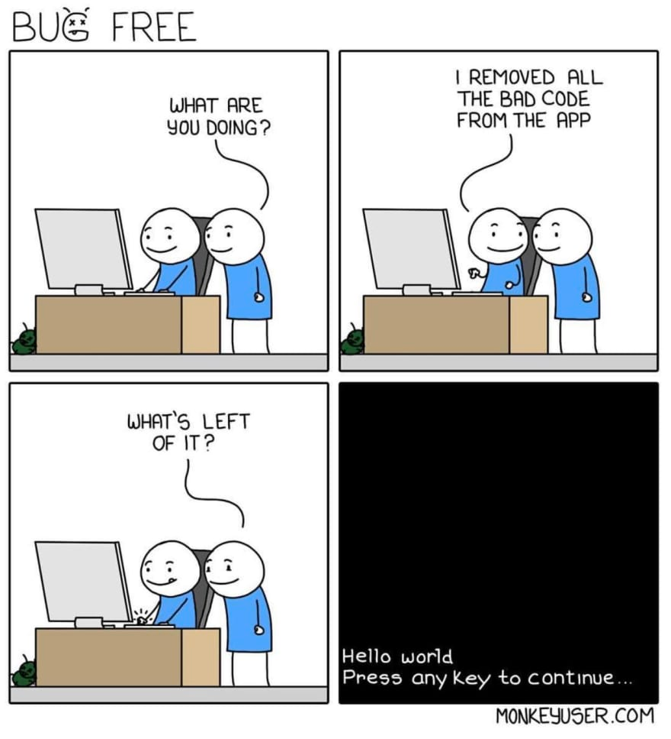
Static code analysis
What to measure?
Reliability
Maintainability
Testability
Portability
Reusability
Notes:
https://www.perforce.com/blog/sca/what-code-quality-and-how-improve-code-quality
And
https://dzone.com/articles/measuring-code-quality-qualitative-and-quantitative

Slide 8
Qualitative vs quantitative measurements
Qualitative:
Opinion based
Subjective and holistic
Quantitative:
Collection of numerical data
Objective and focused
Notes:
These terms are not simply about measuring software quality, but apply also in for example research (qualitative research vs quantitative research).

Slide 9
Static code analysis
Manual (qualitative):
Check SOLID principles
Check documentation
Check programmer intention
Check readability
…
Notes:
No 2 software teams will do a code review in the same manner. Create a code review standard with your project group

Slide 10
Static code analysis
Automated (quantitative):
Cyclomatic complexity
Halstead complexity
Weighted micro function points
Static analysis security testing (STAST)
Etc…
Notes:
Briefly introduce the topic, and probably explain/demo only cyclomatic complexity
https://www.tutorialspoint.com/software_testing_dictionary/cyclomatic_complexity.htm
SAST:
https://securityintelligence.com/static-analysis-security-testing-how-to-get-the-most-from-it/

Slide 11

Static code analysis tool
Notes:
Teacher demo into some of the capabilities of sonarqube, or installing it

